Slide 1






HOOGHLY ENGINEERING & TECHNOLOGY COLLEGE
Final Year Project
(2022-2026)
Web Development
Decentralized Machine Learning Training Platform (PaaS)

Slide 2
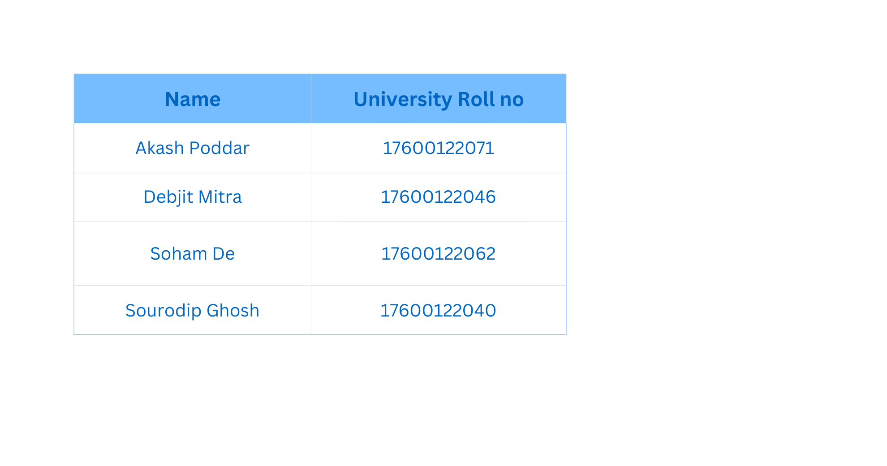
TEAM MEMBERS
Mentored by Assistant Professor Agnimita Banerjee

Slide 3
PROBLEM STATEMENT
The project addresses the fundamental challenge of inefficient and costly resource utilization in Machine Learning (ML) model training, specifically for small-to-medium enterprises (SMEs), researchers, and independent developers.
Cost & Inflexibility: Centralized cloud platforms charge premium, fixed rates, leading to wasted expenditure when resources are not fully utilized.
Untapped Potential: A vast, globally distributed pool of powerful, idle compute resources (GPUs) remains underutilized.
Core Problem

Slide 4
FACTS AND FIGURES
Cloud GPUs cost 2–10 USD per hour, making even mid-sized model training reach ₹15,000–₹50,000 per run. GPU hardware prices have risen 200% (2020–2024), putting local GPU ownership out of reach for most learners and startups.
AI compute needs are growing 2× every six months, far faster than hardware availability. 70% of ML students report they cannot train models effectively due to hardware limits, and 45% of companies face compute-related project delays.
Only 10–15% of ML learners have dedicated GPUs, forcing 80%+ to rely on slow laptops. Training on low-end devices can take 10–20× longer, often extending model training from hours to several days.
Companies locked into a single cloud provider spend 30–40% more over time. High pay-per-use GPU pricing makes cloud-based training unaffordable for students and independent developers.

Slide 5
OUR SOLUTION
Creating a secure, decentralized, consumption-based marketplace (pay-as-you-go).
Efficiently connecting ML model trainers (Job Creators) with a global network of underutilized computational resources (Resource Providers/Worker Nodes).
By creating a platform where users upload a ZIP file containing their training code, data, and dependencies.
A free worker node on the network picks up the job and trains the model on the user’s behalf.
Once training is complete, the user can download the generated model.
They only pay for the resources consumed by the worker without the need for a high-end PC of their own.
To democratize Machine Learning (ML) model training and significantly reduce its cost by:
How do we plan to achieve it?

Slide 6
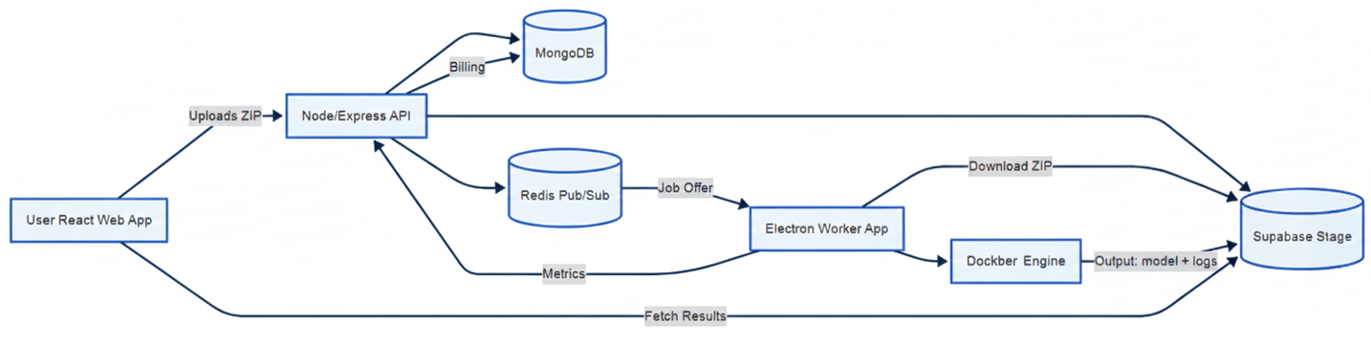
SYSTEM ARCHITECTURE
The user uploads a ZIP file (dataset or training job) from the React web app, which is then sent to the Node/Express API.
The API stores metadata in MongoDB, saves the ZIP file to Supabase Storage, and publishes a job request through Redis Pub/Sub.
The Electron Worker App, subscribed to Redis, receives the job request notification. If any worker present in the network accepts the job, then the ZIP and the metadata are extracted.
The Worker uses Docker to run an isolated ML training container using the downloaded data.
During training, Docker outputs logs, which are streamed to the frontend. After training completion, the Worker uploads the model back to Supabase Storage.
The Worker sends training metrics and usage info to the API, which updates billing and job status in MongoDB.
The user can then fetch results (model files, logs, metrics) directly from Supabase via the React app.

Slide 7
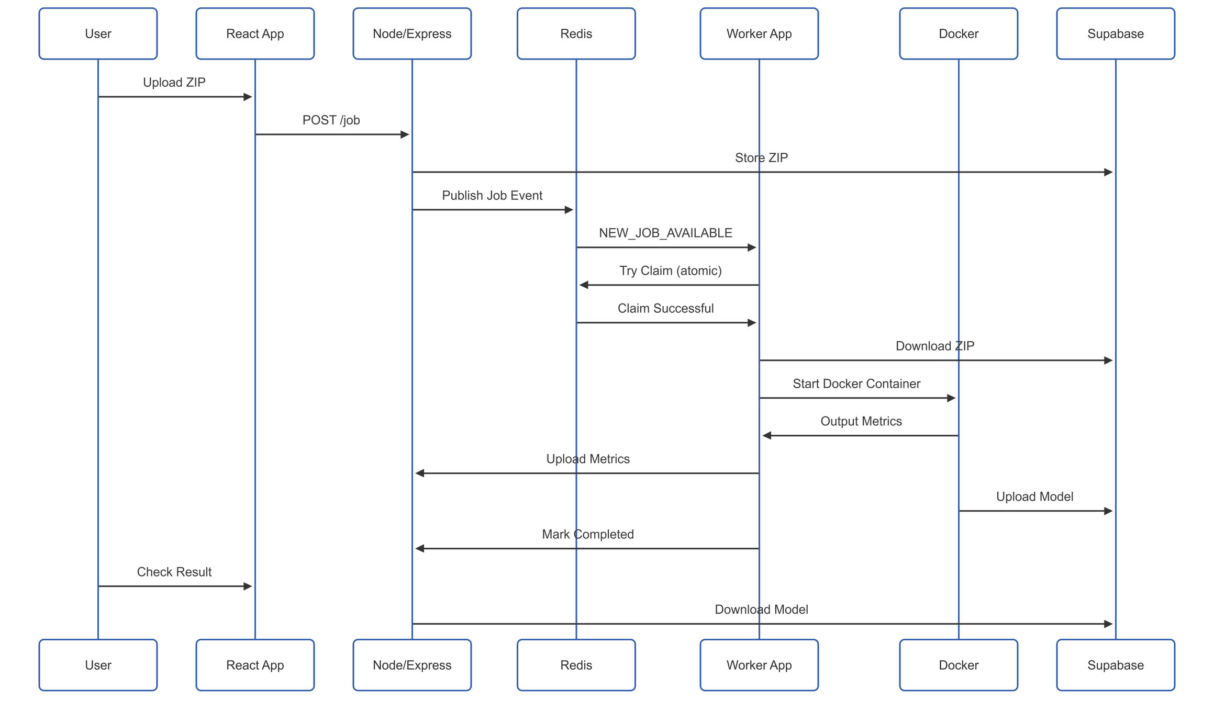
WORKFLOW (SEQUENCE)
Payment

Slide 8
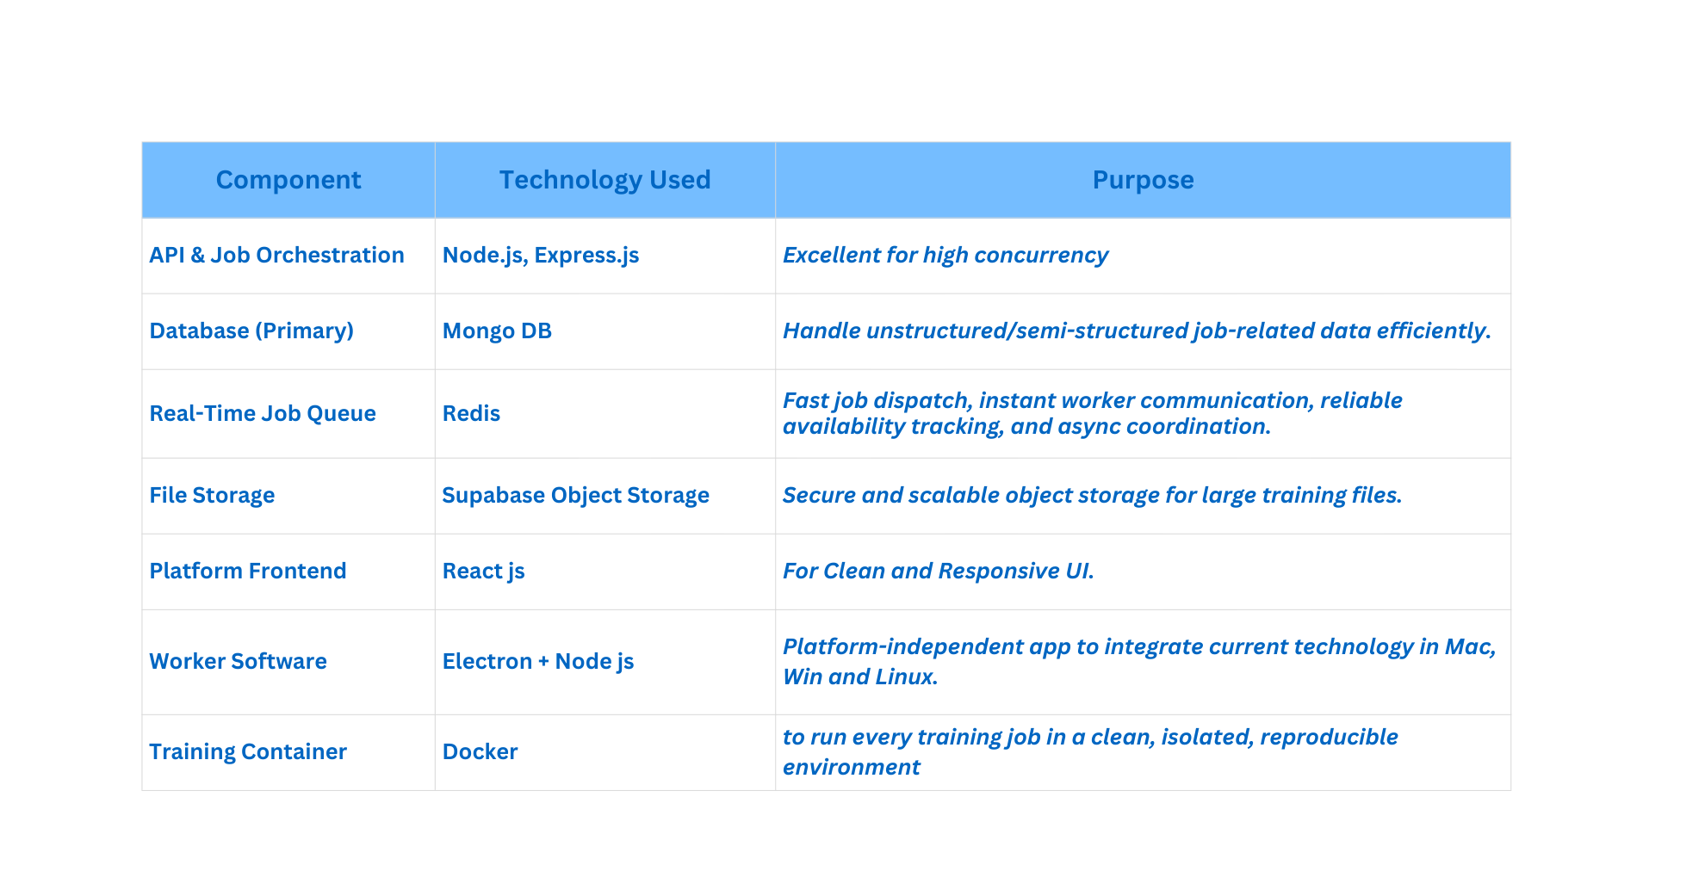
TECH STACK

Slide 9
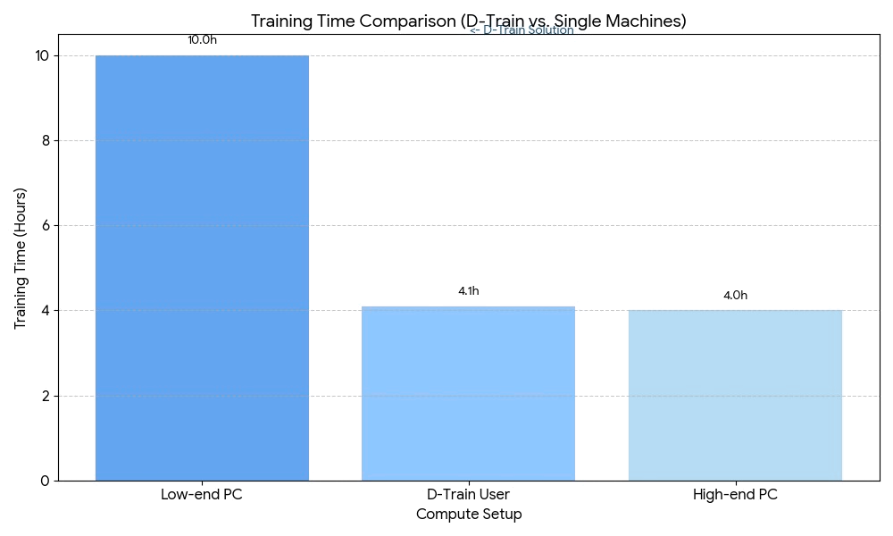
STATISTICS & CONCLUSION
D-Train tackles the lack of accessible, affordable ML compute by using distributed worker nodes, Docker isolation, and real-time Redis orchestration to form a lightweight community-powered training network. Users submit a job, workers do the heavy lifting, and everyone pays only for what they use, without needing a high-end PC.

Slide 10
THANK YOU

